Slide 2
Question 123.15.1
Each degree of freedom contributes how much energy?

Slide 3
Question 123.15.2
In the kinetic theory of gasses, what is temperature?
how much heat you have
the average internal kinetic energy of the gas
the average potential energy of the molecules
the average momentum of the molecules

Slide 4
Question 123.15.3
Two containers hold an ideal gas at the same temperature and pressure. Both containers hold the same type of gas but container B has twice the volume of container A. The average translational kinetic energy per molecule in container B is
Twice that for container A
The same as that for container A
Half that of container A
Can’ Tell

Slide 5
Question 123.15.4
Approximately what is the average velocity of the molecules in this room?
478m/s
1901m/s
101005m/s
0m/s

Slide 6
Diatomic Molecule
z
y
x

Slide 7
Rotational Degrees of Freedom
z
y
x

Slide 8
Vibrational Degrees of Freedom
z
y
x

Slide 9
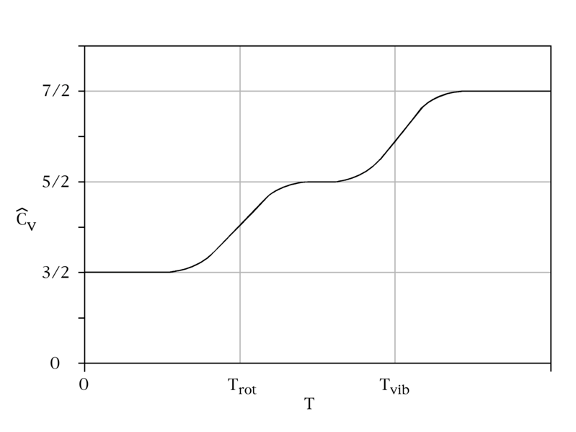
C_{v} vs Temperature

Slide 10
Energy States of a Diatomic Molecule
Available Energy States
Vibrational State
3p
Electronic
State
Roptational State
Increasing Energy
Possible Energy Transitions
2s
Electronic
State

Slide 11
Model of a Solid
z
y
x

Slide 12
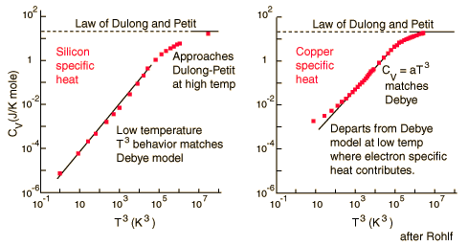
Dulong and Petit Law
http://hyperphysics.phy-astr.gsu.edu/Hbase/thermo/dulong.html

Slide 13
